Slide 1
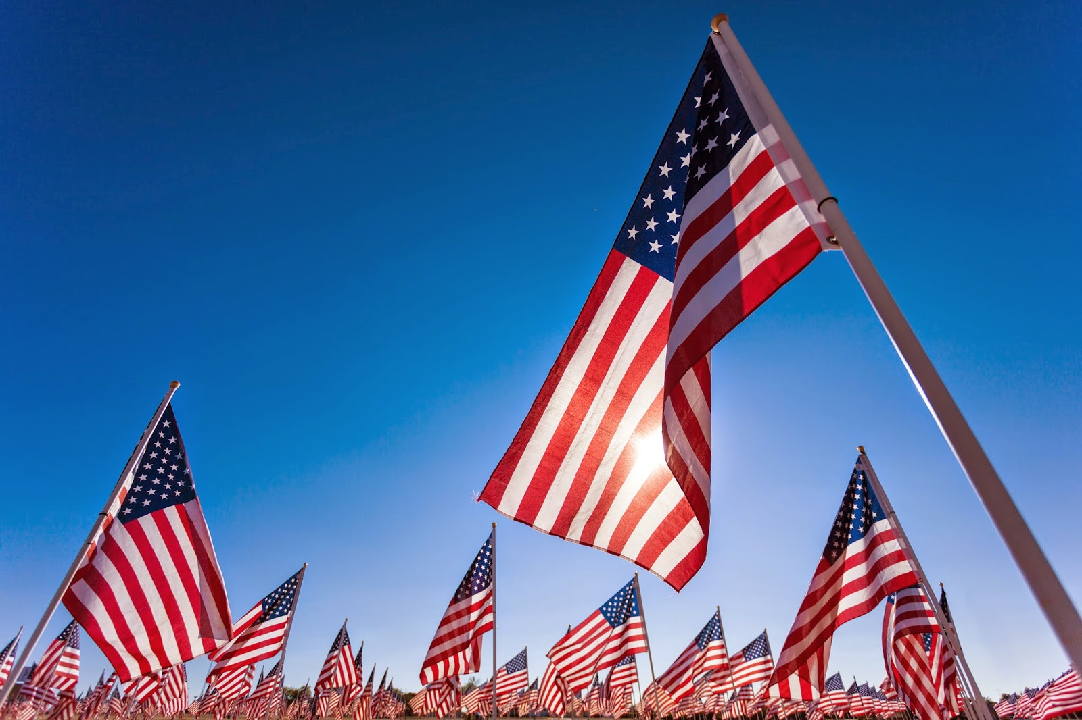
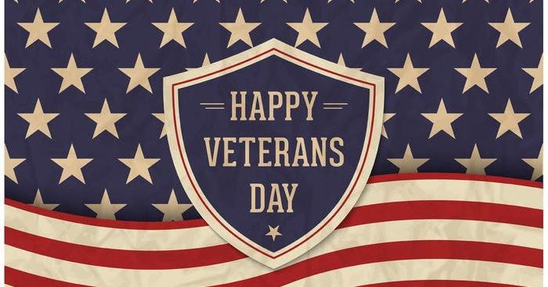
VETERAN’S DAY PROGRAM
November 11, 2021
Welcome Mr. Will Stinson, CD
Pledge of Allegiance Ms. Scarlett Emerson, SGA President
(Please stand and remain standing for the National Anthem)
The Star Spangled Banner Ms. Dorethea Richmond, Student Records Specialist
(National Anthem)
The Voice of a Veteran Ms. DeAndrea McKinney, Academics Manager
Mr. Stephen Burch, CDS Training Manager
Closing Remarks Mr. Will Stinson, CD

Slide 2
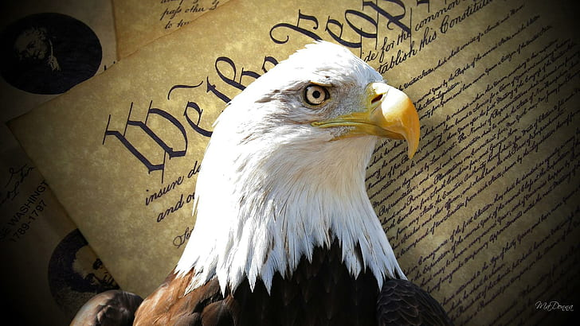
PLEASE THANK OUR VETERAN INSTRUCTORS/STAFF FOR THEIR SERVICE WHEN YOU SEE THEM TODAY OR EVERYDAY. WE HAVE THE LIBERTIES THAT WE HAVE BECAUSE OF THEIR SERVICE AND SACRIFICE.
Doug Abercrombie
John Biggs
Stephen Burch
Larry Davis
Michael Flowers
Charles Higgins, Sr.
DeAndrea McKinney
Lara Murphy
Steven Rusch
Anthony Santamassino
Joseph Smith
David TwoBears
Tonita Warfield
David Wilson

